Slide 1

Procedures and Functions
Prof. Dr. Alp KUT
Asst. Prof. Dr. Derya BİRANT

Slide 2
OUTLINE
Sub-Programs
What is a Procedure?
What is a Function?
Difference Between Procedure and Function
Formal Parameters and Actual Parameters
Parameters and Arguments
Parameter Passing
Examples

Slide 3


Sub-Programs
Sub-programs allow decomposition of a program into logical units.
The best way to develop and maintain a large program is to construct it from smaller pieces each of which is more manageable and more readable than whole program.

Slide 4
Sub-Programs
Main Program
Sub-Program1
Sub-Program2
Sub-Program3
Sub-Program1
End
Sub-Program2
End
Sub-Program3
End

Slide 5

Sub-Programs
Each sub-program provides specific services in a program.
This supports the stepwise refinement approach to problem solving.

Slide 6




Advantages of Sub-Programs
Extensibility: Allows creation of new program modules without affecting existing program modules.
Modularity: Allows breaking a program down into manageable, well-defined logic units.
Reusability: Allows creation of subprograms that can be used by many applications.
Maintainability: Modularity and reusability lead to easier maintenance and enhancement.
Abstraction: Sub-programs provides abstraction, because during use of subpragrams, we must know what they do, not how they work.
Readability: Makes more readable.
Team Working: Allows team working.

Slide 7
Sub-Programs
Two types of sub-programs:
  Procedures
  Functions
Generally, we use
  a procedure to perform an action and
  a function to compute a value

Slide 8
Procedure and Function
A procedure is a unit of code that performs an action within a program but may return no value.
A function is a unit of code that arguments are passed to it and are processed to compute a single value that must be returned.

Slide 9
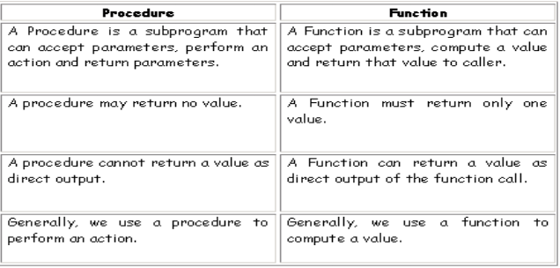
Difference between Procedure and Function

Slide 10
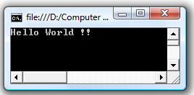
Procedure Definiton in C#
Procedures are declared within a static void {...} block.
The name of the procedure must be specified.
Example:
static void MyFirstProcedure()
{
Console.WriteLine("Hello World !!");
}
static void Main(string[] args)
{
MyFirstProcedure();
Console.ReadLine();
}

Slide 11
Example
static void Menu()
{
Console.WriteLine("-------------- MENU --------------");
Console.WriteLine("- 1) The area of a square -");
Console.WriteLine("- 2) The area of a rectangular -");
Console.WriteLine("----------------------------------");
}
static void Square_Area()
{
Console.Write("Enter the edge length of the square");
int a = Convert.ToInt16(Console.ReadLine());
Console.WriteLine(a * a);
}
static void Rectangular_Area()
{
Console.Write("Enter the width of the rectangular");
int a = Convert.ToInt16(Console.ReadLine());
Console.Write("Enter the length of the rectangular");
int b = Convert.ToInt16(Console.ReadLine());
Console.WriteLine(a * b);
}
static void Main(string[] args)
{
Menu();
int choice = Convert.ToInt16(Console.ReadLine());
if (choice == 1)
Square_Area();
else if (choice == 2)
Rectangular_Area();
else
Console.WriteLine("Wrong number");
Console.ReadLine();
}

Slide 12
Parameters
A parameter is a variable whose value is passed to the procedure when the procedure is called.
Empty parentheses indicate that the procedure requires no parameters.
static void Menu()
{ ... }
static void Main(string[] args)
{ Menu(); }
If the procedure has parameters, parameters are surrounded by parentheses, and separated by commas.
static void Menu(string usertype)
{ ... }
static void Main(string[] args)
{ Menu("admin"); }

Slide 13
With a Parameter Without Parameter
static void Menu(string usertype)
{
if (usertype = "admin")
{
Console.WriteLine("---- MENU ----");
Console.WriteLine("- 1)Insert -");
Console.WriteLine("- 2)Delete -");
Console.WriteLine("- 3)Exit -");
Console.WriteLine("--------------");
}
else if (usertype = "normal")
{
Console.WriteLine("---- MENU ----");
Console.WriteLine("- 1)List -");
Console.WriteLine("- 2)Exit -");
Console.WriteLine("--------------");
}
}
static void Main(string[] args)
{
...
if (....)
Menu("admin");
else
Menu("normal");
...
}
static void Menu1()
{
Console.WriteLine("---- MENU ----");
Console.WriteLine("- 1)Insert -");
Console.WriteLine("- 2)Delete -");
Console.WriteLine("- 3)Exit -");
Console.WriteLine("--------------");
}
static void Menu2()
{
Console.WriteLine("---- MENU ----");
Console.WriteLine("- 1)List -");
Console.WriteLine("- 2)Exit -");
Console.WriteLine("--------------");
}
static void Main(string[] args)
{
...
if (....)
Menu1();
else
Menu2();
...
}

Slide 14
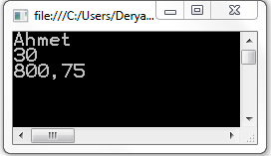
Parameters
The data type and a name for each parameter must be specified.
static void MyProcedure(string a, int b, double c)
{
Console.WriteLine(a);
Console.WriteLine(b);
Console.WriteLine(c);
}
static void Main(string[] args)
{
string name = "Ahmet";
int age = 30;
double salary = 800.75;
MyProcedure(name,age,salary);
}

Slide 15
Parameter Types
Two Parameter Types:
Formal Parameters: They are declared in the parameter list of procedure definition.
Actual Parameters: They are refenced in a procedure call.
static void MyProcedure(string a, int b, double c)
{
Console.WriteLine(a);
Console.WriteLine(b);
Console.WriteLine(c);
}
static void Main(string[] args)
{
string name = "Turabi";
int age = 30;
double salary = 800.75;
MyProcedure(name,age,salary);
}
Formal Parameters
Actual Parameters

Slide 16
Parameter Types
The order of elements in an actual parameter list shall be the same as the order in which they appear in the corresponding formal parameter.
The formal parameter and the actual parameter that corresponds to the formal parameter (when called) must be of the same datatypes.
static void MyP(string a, int b, double c)
{ ... }
static void Main(string[] args)
{
string x; int y; double z;
MyP(y,x,z);
}
static void MyP(string a, int b, double c)
{ ... }
static void Main(string[] args)
{
string x, y; double z;
MyP(x,y,z);
}
different order
different data type

Slide 17
Parameters and Arguments
An argument represents the value you supply to a procedure parameter when you call the procedure.
static void MyP(int a, int b)
{
Console.WriteLine(a + b);
}
static void Main(string[] args)
{
int value1 = 40;
int value2 = 2;
MyP(value1, value2);
}
Formal Parameters:
Actual Parameters:
Arguments:
a, b
value1, value2
40, 2

Slide 18

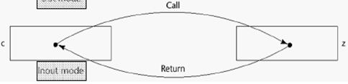
Parameter Passing
Parameters can be passed either by value or by reference.
By Value
Sends a copy value to the procedure so that the procedure cannot alter the original value of the actual parameter.
By Reference
Sends a reference indicating where the value is stored in memory, allowing the called procedure to change the actual parameter’s original value.
sub(a,b);
static void sub(int x, int y)
b
y

Slide 19


Parameter Passing Example
// Passing by value
static void MyP(int x)
{
x = x + 5;
}
static void Main(string[] args)
{
int a = 1;
MyP(a);
Console.WriteLine(a);
}
// Passing by reference
static void MyP(ref int x)
{
x = x + 5;
}
static void Main(string[] args)
{
int a = 1;
MyP(ref a);
Console.WriteLine(a);
}

Slide 20
Function
Function is a sub-program that returns a value.
Return keyword must be used in a function.
Instead of using void keyword, the type of the return value must be defined.
Function
Argument
processing
Return value

Slide 21

Example Function
static int Sum(int a, int b)
{
return a + b;
}
static void Main(string[] args)
{
int number1 = 3;
int number2 = 5;
int result;
result = Sum(number1, number2);
Console.WriteLine(result);
}

Slide 22
Functions
Main Program
a = F1 (number1);
b = F1 (number2);
c = F2 (number1, number2) + F3(5);
static int F1(int n) {
return ...
}
static int F2(int x,y) {
return ...
}
static int F3(int k) {
return ...
}

Slide 23
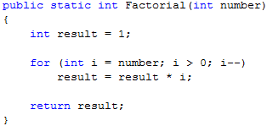
Example
Write a program that finds the factorial of a number
static void Main(string[] args)
{
int result;
result = Factorial(5);
Console.WriteLine(result);
Console.ReadLine();
}

Slide 24

Example
Write a program that computes the area of the red doughnut?
static double FindCircleArea(double r)
{
double area;
area = r * r * 3.14;
return area;
}
static void Main(string[] args)
{
double r1, r2, result;
Console.Write("Enter first circle radius: ");
r1 = Convert.ToDouble(Console.ReadLine());
Console.Write("Enter second circle radius: ");
r2 = Convert.ToDouble(Console.ReadLine());
result = FindCircleArea(r1) - FindCircleArea(r2);
Console.WriteLine(result);
}

Slide 25
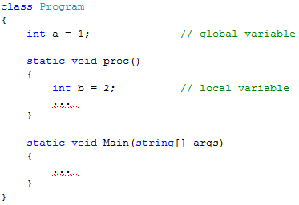
Local vs. Global Variable
Global variables
  available at all times from anywhere
  created at the start of the program, and lasts until the end
Local variables
  simply created when they are needed
  only available from within the subroutine in which they were created

Slide 26
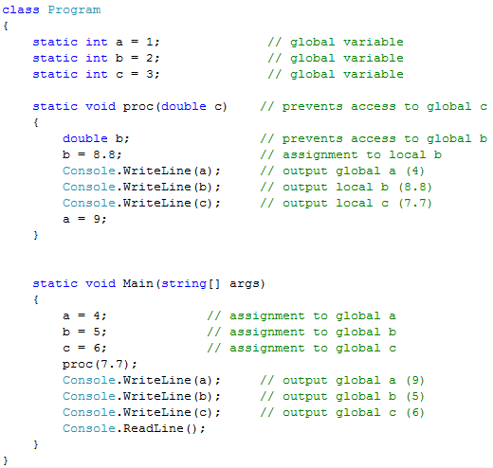
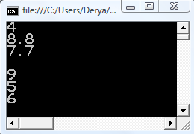
Global variable
Local variable

